Slide 1
Part 4: Information Extraction

Slide 2
4.1 Named Entity Recognition

Slide 3
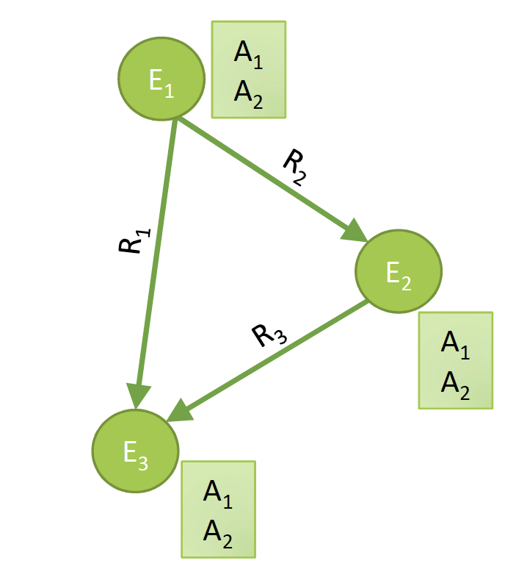
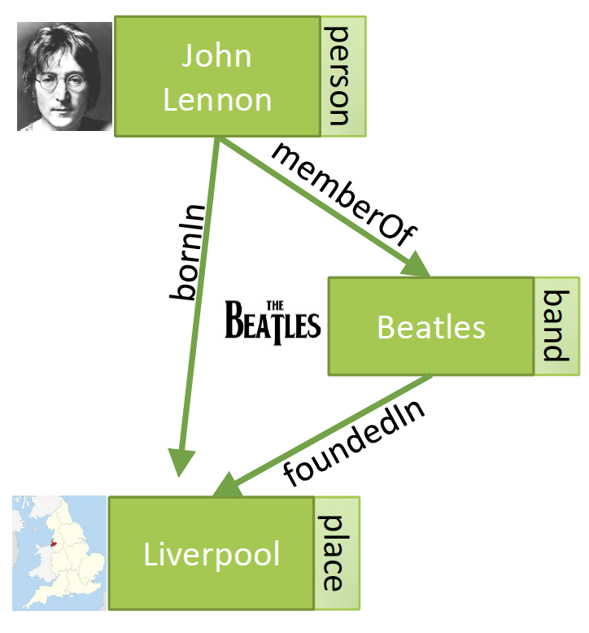
Knowledge Graphs (Google 2012)
Notes:
One model for representing ontologies that has gained large popularity recently are knowledge graphs. They are based on a graph-based representations of basic first order logic constructs, entities, which are elements from given domains, relationships, which are binary relations and attributes which are relations among entities and values from a standard data structure.

Slide 4
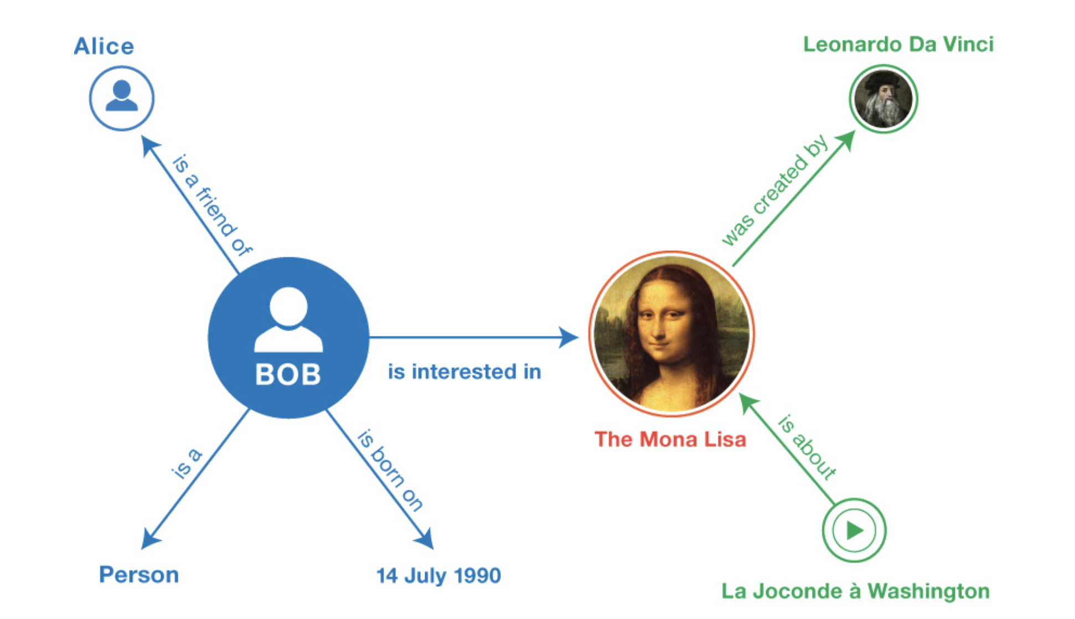
RDF – Resource Description Framework (W3C 2004)
Notes:
In fact, long before knowledge graph have become popular, a similar model has been developed by the W3C, the Resource Description Framework. It has the same basic concepts as knowledge grpahs, together with some additional modeling primitives. We will provide an overview of RDF in the following.

Slide 5
Entity-Relationship Model
The Entity Relationship Model: Toward a Unified View of Data, Peter Pin-Shan Chen, 1976
Notes:
The approach of using concepts from first order logic for modeling reaches however far back in history. In the area of database management systems, the entity-relationship model has been established as a standard approach for data modeling already in 1976. The main difference is in the intended use of the model at the time. It was used to provide a conceptual model of an application domain and then to derive in a mostly automated way a database schema (in other words data structures) in the data model supported by the target database management system. This model typically is the relational data model.

Slide 6
Populating Knowledge Bases
Manual creation of knowledge bases is expensive
Can we produce them automatically?
Idea: Extract knowledge from documents
Challenge: Knowledge is encoded in natural language
Objectives
Automated or accelerated creation of knowledge bases
Support for structured search on documents
Notes:
Traditionally knowledge bases are created manually, either by experts (e.g., WordNet) or by crowd-sourcing (e.g., WikiData). This is expensive. In the case of WordNet, it took tens of years to construct the knowledge base, in the case of WikiData (resp. WikiPedia) we all know about the notorious difficulty to finance this endeavor. Therefore, an interesting question is whether such knowledge bases could not be automatically constructed.
For automatic construction we can exploit data that is digitally available, e.g., all documents accessible on the Web. These documents encode massive human knowledge in natural language. The challenge is to extract such knowledge by analyzing natural language text, which is not an easy problem.
The results would, however, be immensely useful. First, we could create massive knowledge bases in a nearly automated way, and furthermore these knowledge bases could be used to annotate documents, for supporting more expressive and precise searches and analyses.

Slide 7
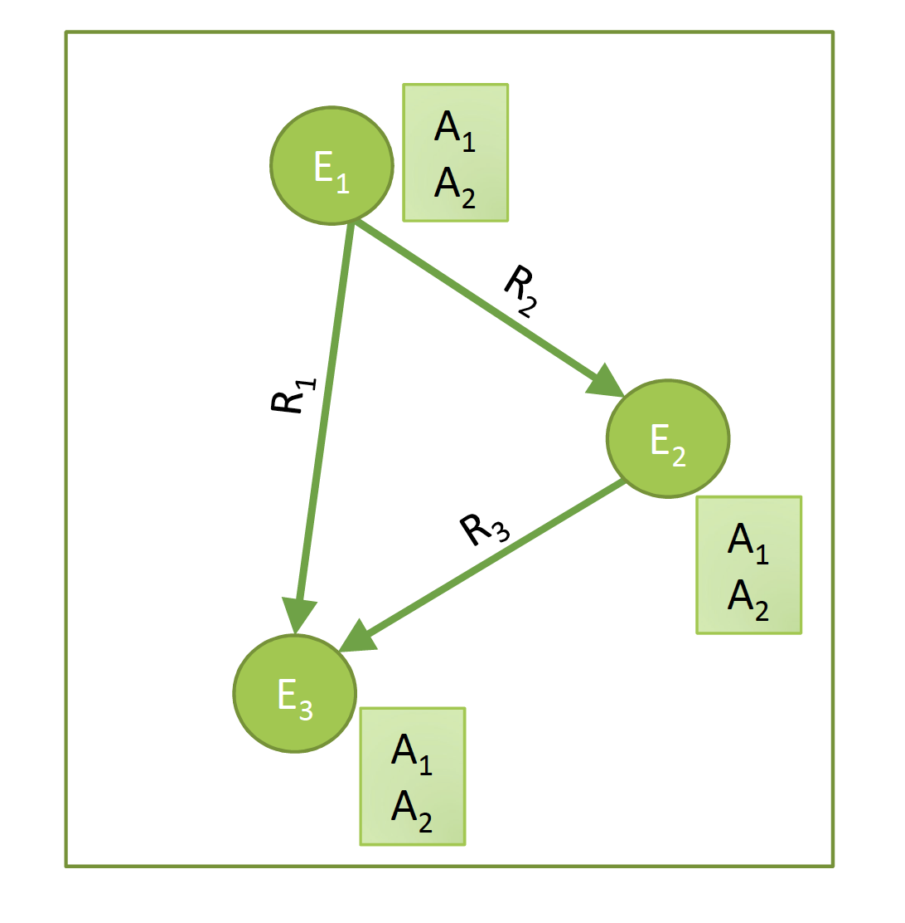
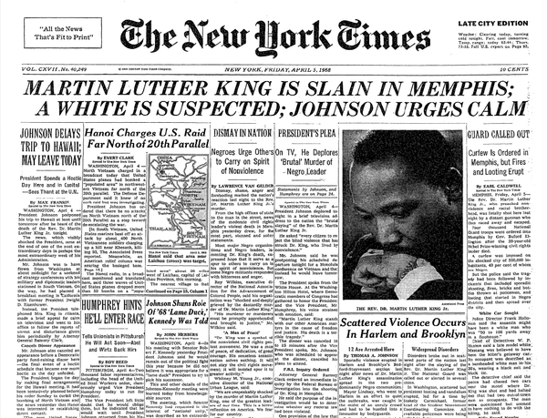
Information Extraction
From text to knowledge
Who are the entities?
What are their attributes?
How are they related?
Notes:
For investigating knowledge extraction, more commonly called information extraction, from textual content, we can consider the different constituents of a knowledge graph separately: entities, attributes and relationships. We will now introduce methods for extracting entities and then for establishing relationships among entities and with attributes.

Slide 8
4.1.1 Key Phrase Extraction
Idea: key phrase extraction is “the automatic selection of important and topical phrases from the body of a document” (Turney, 2000)
Document summarization, search and indexing
Document classification and opinion mining
EPFL is one of the two Swiss Federal Institutes of Technology. With the status of a national school since 1969, the young engineering school has grown in many dimensions, to the extent of becoming one of the most famous European institutions of science and technology. Like its sister institution in Zurich, ETHZ, it has three core missions: training, research and technology transfer. Associated with several specialised research institutes, the two Ecoles Polytechniques (Institutes of Technology) form the EPF domain , which is directly dependent on the Federal Department of Economic Affairs, Education and Research (EAER).
Notes:
A first type of information extraction method is key phrase extraction. Key phrase extraction aims at identifying words and phrases that are typical for a document and characterize important concepts that occur in a document. Key phrase extraction has been developed to support document summarization, where the key phrase gives an overview of the key concepts of a document. Key phrase extraction supports also document search and indexing, where key phrases are used to index documents. Moreover, key phrases can also provide useful features for document classification, i.e., key phrase extraction can be considered as a feature selection method. In the example text we see the possible outcome of key phrase extraction, with all identified key phrases marked in bold.

Slide 9
Keyphrase Extraction Methods
Approach: generate candidate phrases and rank them
Candidate phrases
Remove stopwords
Use word n-grams
Consider part-of-speech tags (POS)
Baseline ranking approach
rank candidate phrases of the document according to their tf-idf value
Advanced approaches
Use of many structural, syntactic features of the documents
Use of external resources, such as Wikipedia, Wordnet
Use of transformer models
Notes:
The basic approach to key phrase extraction uses principles well known from information retrieval. As in information retrieval stopwords are excluded. Key phrase candidates can be all word n-grams in the remaining text. Furthermore, part-of-speech tags can be used to further select the candidates, e.g., for excluding all verb phrases.
In order to assess whether a candidate phrase is characteristic for a document, tf-idf ranking is a possible approach. As in IR a candidate phrase is considered as relevant for a document if it is at the same time frequent and specific. Apart from that, many heuristics have been developed to refine this approach, considering additional features of the document. For example, a phrase in the title or a header could be considered as more relevant. External knowledge bases could be used to check whether a phrase corresponds to a commonly known concept. Recently, also transformer models have been applied for the task of key phrase extraction.

Slide 10
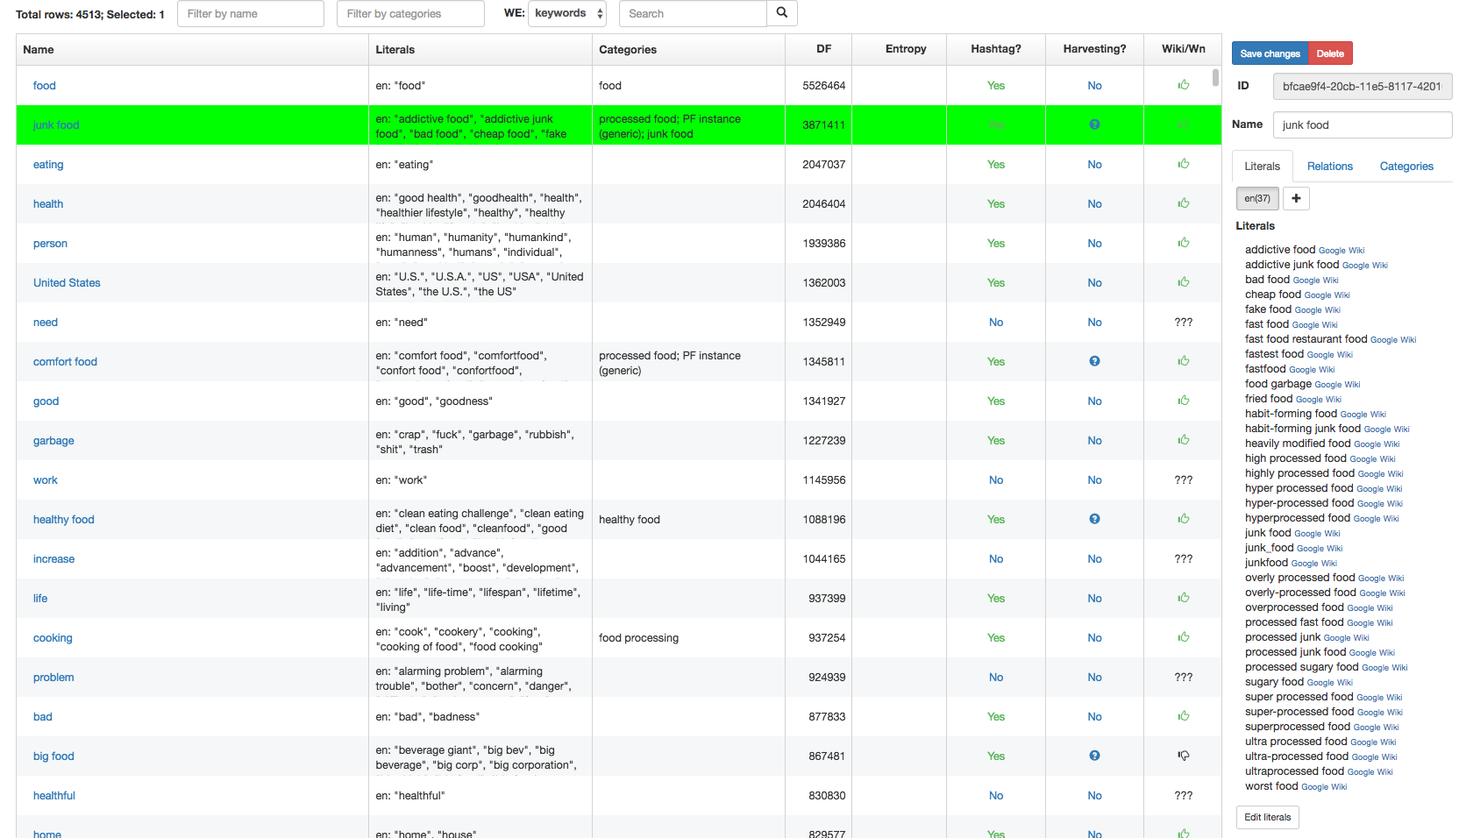
Use of Keyphrase Extraction
Creation of domain-specific thesaurus and taxonomy
Notes:
Key phrase extraction can be used as an initial step to create a domain-specific thesaurus or taxonomy. In the example, we see a thesaurus that has been constructed for the food domain, based on key phrase extraction. For the phrase “junk food” many synonyms and near-synonyms have been identified. In practice a human expert would not be able to extract reliably all different types of mentions of such a concept.
As a result, this allows to increase recall for retrieval of documents that refer to this concept.

Slide 11
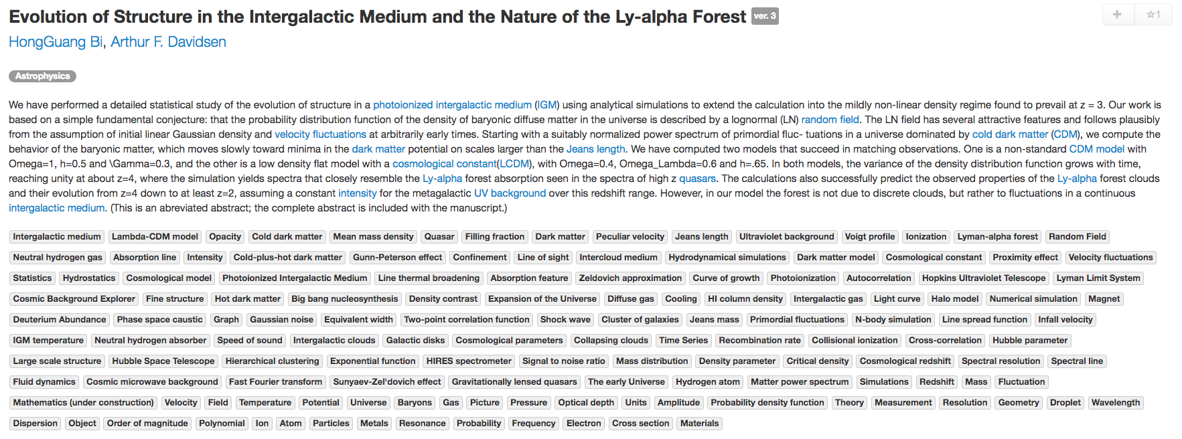
Use of Keyphrase Extraction
Document classification and search
sciencewise.info
Notes:
This is an example of using key phrase extraction for scientific documents in physics. Many highly specific concepts are identified automatically and allow a scientist to more precisely filter and search the documents. You can try this out on your own at sciencewise.info.

Slide 12
4.1.2 Named Entity Recognition (NER)
Task: Find and classify names of people, organizations, places, brands etc. that are mentioned in documents
EPFL is one of the two Swiss Federal Institutes of Technology. With the status of a national school since 1969, the young engineering school has grown in many dimensions, to the extent of becoming one of the most famous European institutions of science and technology. Like its sister institution in Zurich, ETHZ, it has three core missions: training, research and technology transfer. Associated with several specialised research institutes, the two Ecoles Polytechniques (Institutes of Technology) form the EPF domain , which is directly dependent on the Federal Department of Economic Affairs, Education and Research (EAER).
EPFL is located in Lausanne in Switzerland, on the shores of the largest lake in Europe, Lake Geneva and at the foot of the Alps and Mont-Blanc. Its main campus brings together over 11,000 persons, students, researchers and staff in the same magical place.
organization
organization
georegion
city
Notes:
Named entity recognition is a more specific task than key phrase extraction. In NER the objective is to identify phrases that are names of specific types of entities, such as people, organizations or places. This, again, is very useful for document classification and search, but also a steppingstone to extract more complex knowledge, in particular statements relating different entities, as we will see later.

Slide 13
Named Entity Recognition (NER)
Uses of NER
Named entities can be indexed, linked, etc.
Sentiment can be attributed to companies or products
Information extraction can use named entities as anchors
Commercial tools available
Reuters’ OpenCalais, AlchemyAPI (now IBM)
Python libraries: NLTK NER, Spacy
Notes:
NER has many commercial applications, e.g., for marketing or studying public perception, by linking volume of communication, sentiment and popularity to specific entities, such as products, companies or organizations. Thus, there exist manycommercial tools that offer this type of service.

Slide 14
NER as Sequence Labelling Task
Sequence of tags, indicating whether a word is inside (I) or outside of an entity (O)
The occurrences of entities (can be) typed
EPFL is located in Lausanne in Switzerland , next to Lake Geneva
I O O O I O I O O O I I
ORG GEO GEO GEO GEO
A classification problem!
Notes:
The basic task of NER is to detect whether a word belongs to an entity name or not. Furthermore, when an entity name is detected, it can be classified according to the type of the entity, e.g., an organisation (ORG), a location (GEO), a person etc.
When analyzing a text, NER is thus a classification problem, where for each word it needs to be decided whether it is inside or outside of an entity name. More detailed classifications, whether a word is the beginning or end of entity name, can also be performed. Note that in this context also punctuation marks are considered as words, as they may carry important information on the presence of an entity.

Slide 15
NER as Classification Task
EPFL is located in Lausanne in Switzerland , next to Lake Geneva
I O O O I O I
Next predicted label
Features:
Neighboring words
Preceding labels
Classifier
Naïve Bayes, HMM, CRF, …
Notes:
Given that NER can be considered as a classification problem, we must decide on two questions. First, which are the input features for the classifier, and second, which is the classification algorithm to be used. As for the input features, typically the neighborhood of a word is considered. In this neighborhood we find other words, which can be used as directly as features and from which several derived features can be produced. The classifier classifies words while reading the words in the sequence they appear in the document. Therefore, one special kind of feature that is used in NER are the labels that have been produced by the classifier for words preceding the word to be classified. Even though in principle any classification algorithm could be applied, e.g., Naïve Bayes, specific sequence-oriented classifiers (HMM, CRF) can have better performance.

Slide 16
Features used in NER
EPFL is located in Lausanne in Switzerland , next to Lake Geneva
Features of “Lausanne”:
Word and neighboring words: Lausanne, in
Part-of-speech tags (POS): POS(Lausanne) = NN
Prefixes and Suffixes: prefix(Lausanne, 3) = Lau
Word shape: WS(Lausanne) = Xxxxxxxx
Short wordshape: SWS(Lausanne) = Xx
Notes:
Here we see a list of typical features that are used in named entity recognition. Some of them are quite specific to the task. For example, part-of-speech tags can be helpful as they allow to distinguish noun phrases (NN) which are typical for entities. Pre- and suffixes are another interesting feature. For example, words ending in “land” would often be locations. Learning this fact can help to generalize the classification to new terms that would contain such a suffix. For entities, in particular in English, also the word shape is an important feature, as usually proper names start with capital letters, or acronyms consist of capital letters only.

Slide 17
Exploiting Context
When deciding the entity type exclusively on local context, important information may be missed
The release of Harry Potter and the Philosopher's Stone in 2001 was Watson's debut screen performance
Although the system is primarily an IBM effort, Watson's development involved faculty and graduate students
Idea: consider a model that takes into the account the sequential structure of language and exploits sentence context
Notes:
If only features derived from the local context from the immediate neighborhood of a word to be classified are used, important context information can be missed. This motivated the use of classification models that exploit the larger context of a word in the text, like the complete sentence in which the word occurs.

Slide 18
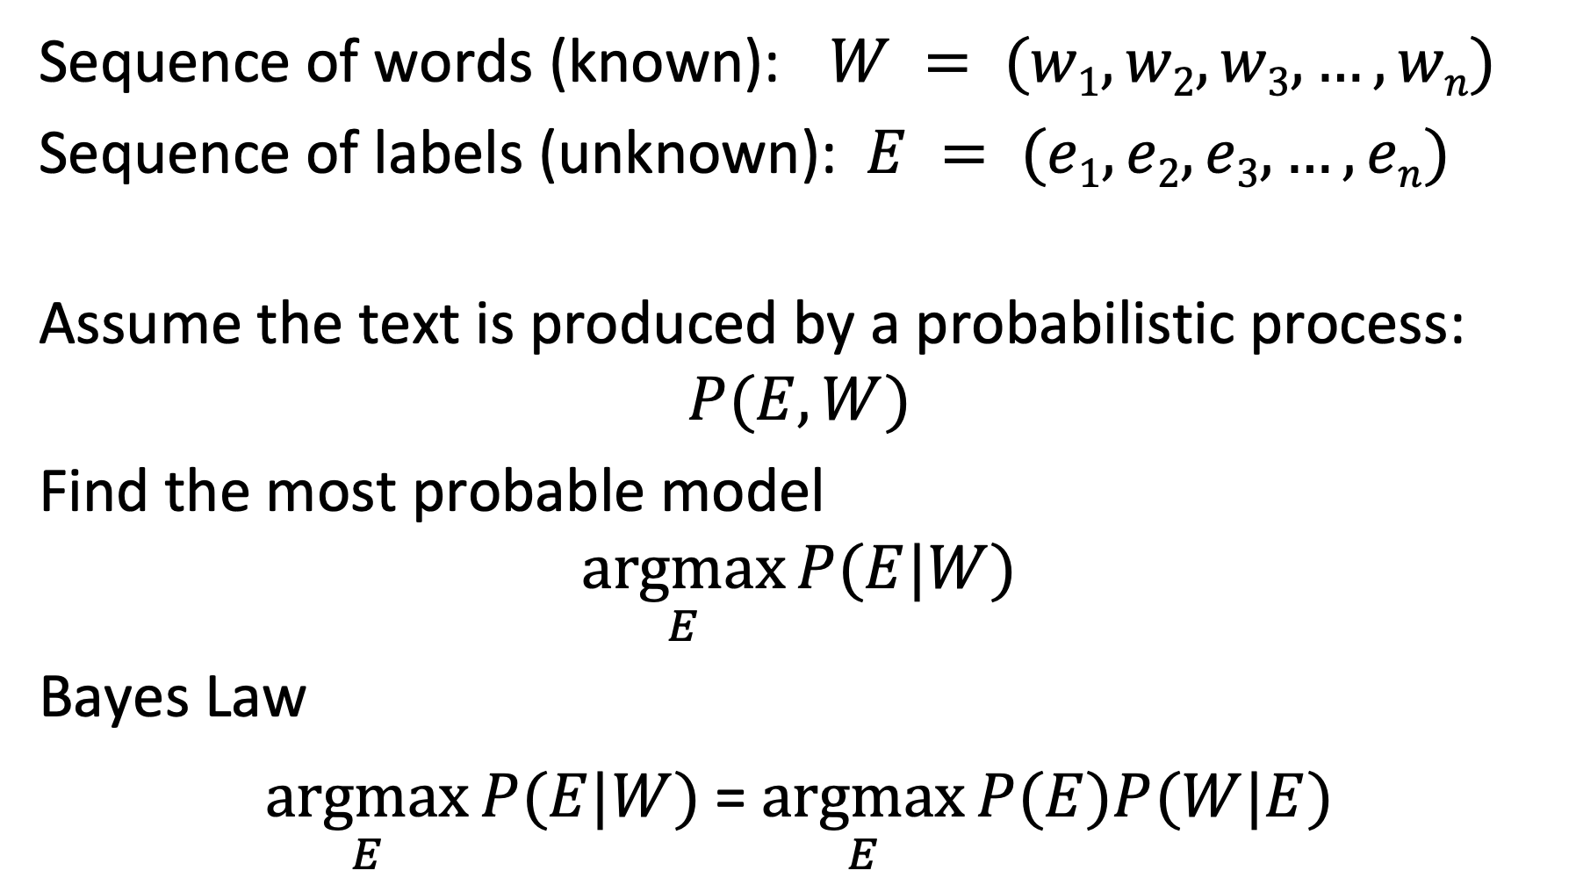
Generative Probabilistic Model
Sequence of words (known): $W = (w1, w2, w3, …, wn)$
Sequence of labels (unknown): $E = (e1, e2, e3, …, en)$
Assume the text is produced by a probabilistic process:
$$P(E,W)$$
Find the most probable model
$$\underset{E}{argmax}{P(E|W)}$$
Bayes Law
$\underset{E}{argmax}{P(E|W)}$= $\underset{E}{argmax}{P(E)P(W|E)}$
Notes:
We introduce now a classification approach that has been used for NER and exploits the sequential nature of natural language. The approach belongs to the class of generative probabilistic models, like the one we have introduced for information retrieval.
The basic model assumes that there exists a (unknown) probability distribution $P(E,W)$ that correlates sequences of words with the corresponding sequences of entity labels. The classification task is then to identify for a given sequence of words, the most probable sequence of labels. Using Bayes law, we can reformulate this, by decomposing the conditional probability $P(E|W)$ into the product of two probability distributions. $P(E)$is a model describing of the probability of different labels to occur, and $P(W|E)$ is a model describing of how words correlate with labels.

Slide 19
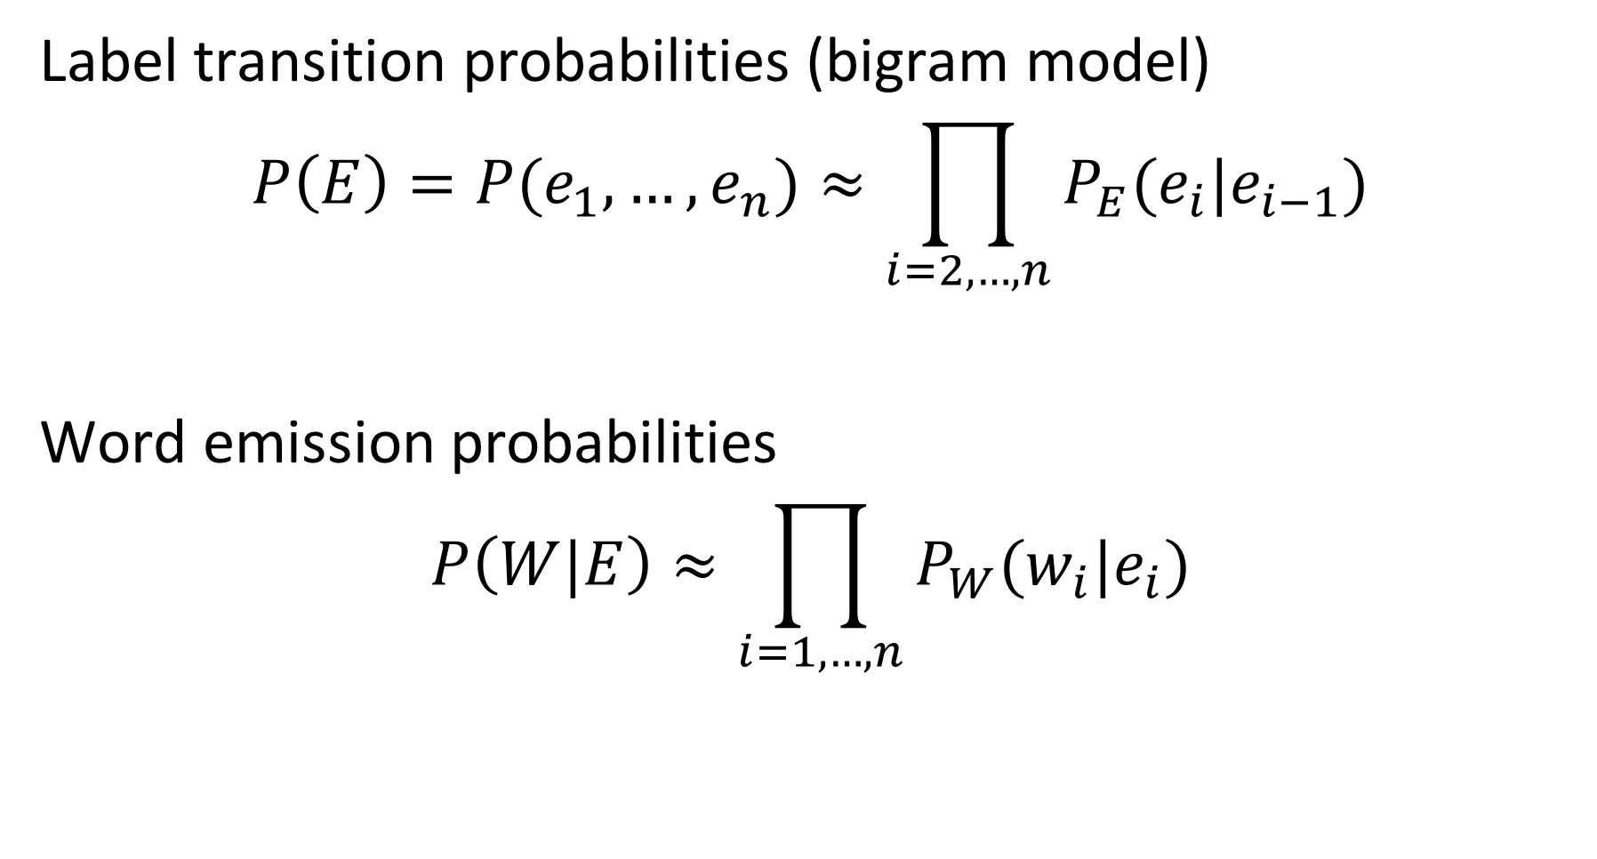
Approximation
Label transition probabilities (bigram model)
$$P\left(E\right)=P(e_{1},…,e_{n})≈\prod_{i=2,…,n}{P_{E}(e_{i}|e_{i−1})}$$
Word emission probabilities
$$P\left(W|E\right)≈\prod_{i=1,…,n}{P_{W}(w_{i}|e_{i})}$$
Notes:
As it is not possible to estimate the complete probability distribution functions $P(E)$and $P(E|W)$, we approximate them by making independence assumptions. We assume that the probability of a label to occur, depends only on the previous label. This corresponds to a bigram model, generalizing the unigram model we have introduced in probabilistic information retrieval. For a word we assume that its probability of occurrence depends only on the label it received. Thus, the two probability functions decompose into products of simpler functions that we can estimate.

Slide 20
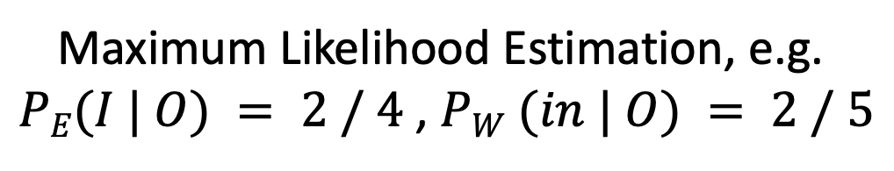
Hidden Markov Model (HMM)
Graphical representation of the approximate probabilistic model
EPFL
is
located
in
Lausanne
in
Switzer land
,
P_{W}(EPFL | I)
P_{W}(is| O)
P_{W}(located | O)
…
START
I
O
O
O
I
O
I
O
P_{E}(I | START)
P_{E}(O | I)
P_{E}(O | O)
P_{E}(O | O)
P_{E}(I | O)
P_{E}(O | I)
P_{E}(I | O)
P_{E}(O | I)
Maximum Likelihood Estimation, e.g.
$PE(I | O) = 2 / 4$, $PW (in | O) = 2 / 5$
Notes:
We can represent approximate model of the probability distribution graphically as a Markov Model, where we indicate which probabilistic variables depend on which others. More precisely, it is a Hidden Markov Model (HMM). The hidden labels E are unknown, and their probabilities need to be estimated from the words that can be observed.
This approach for estimating probabilities of hidden variables with HMMs can be applied to other sequence labelling tasks. For example, it can be used to learn part-of-speech tags and the types of the entities.

Slide 21
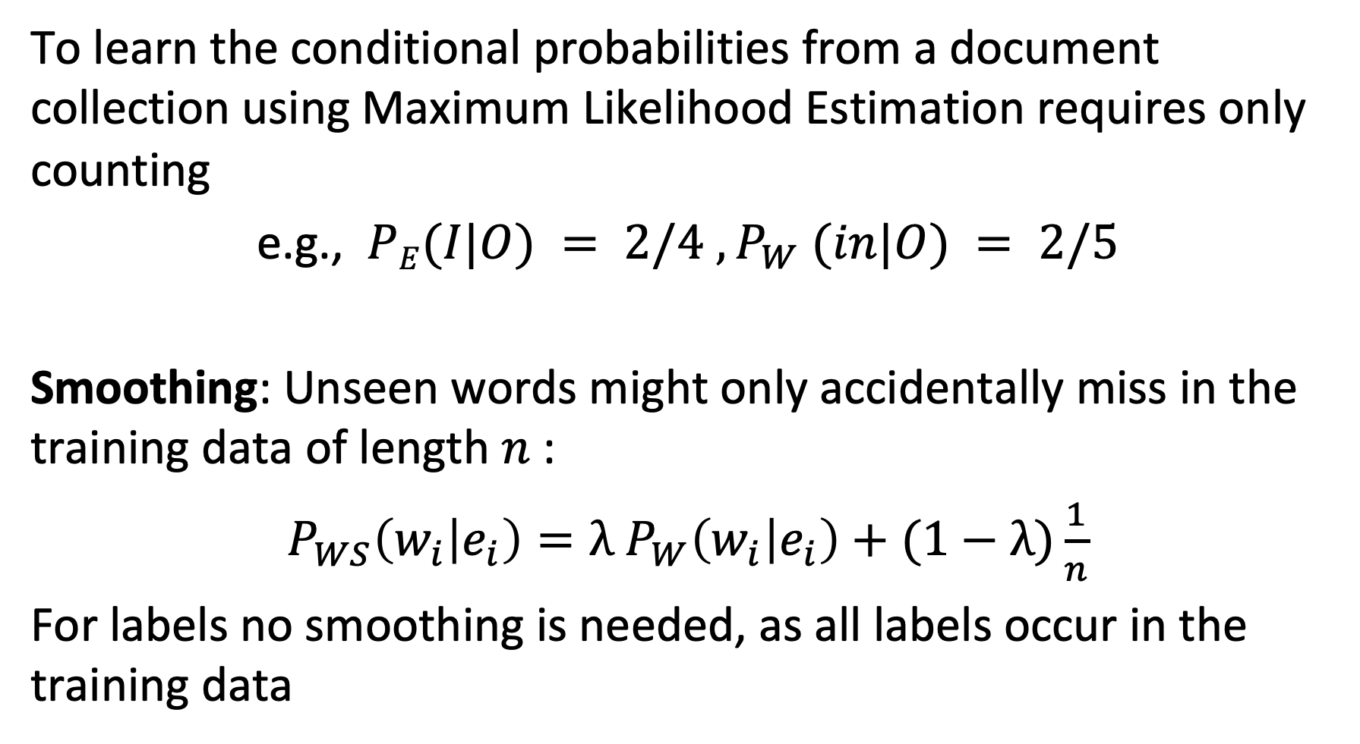
Learning the Model
To learn the conditional probabilities from a document collection using Maximum Likelihood Estimation requires only counting
e.g., $PE(I|O) = 2/4 , P_{W} (in|O) = 2/5$
Smoothing: Unseen words might only accidentally miss in the training data of length $n$:
$P_{WS}\left(w_{i} | e_{i}\right)=λ$ $P_{W}\left(w_{i} | e_{i}\right)+(1−λ)\frac{1}{n}$
For labels no smoothing is needed, as all labels occur in the training data
Notes:
Given a document collection we can estimate the probabilities $P_{E}(e_{i}|e_{i−1})$ and $P_{W}(w_{i}|e_{i})$. As in probabilistic information retrieval we use maximum likelihood estimation. For example, for estimating the probability $P_{E}(e_{i}|O)$ we count the total number of occurrences of O, and then compute the ratio between the cases where the preceding label is $e_{i}$ with the total number of occurrences of O.
As in probabilistic information retrieval, we need to consider the issue of sparsity of words in the training set. It might be the case that a specific word does not occur together with a given label in the training data, whereas this word still might be related to the label in general. Therefore, smoothing is applied, where the smoothing parameter depends on the size of the training data. The more data is available, the less the likelihood that a word-label pair that is likely to occur is not found in the training data.
For estimating the probability of labels to occur, no smoothing is required, as the number of labels is very small and thus all pairs of labels combinations are likely to occur in the training data.

Slide 22
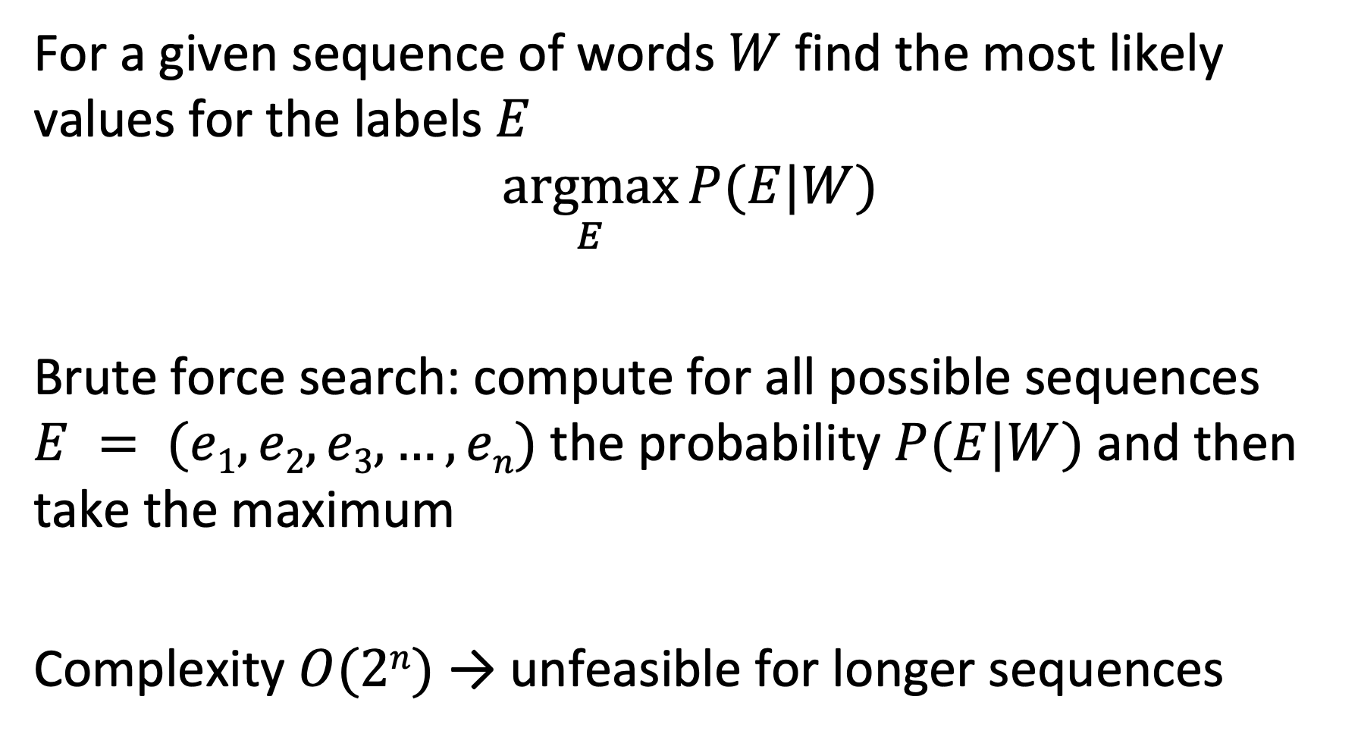
Using the Model
For a given sequence of words $W$ find the most likely values for the labels $E$
$$\underset{E}{argmax}{P(E|W)}$$
Brute force search: compute for all possible sequences $E = (e1, e2, e3, …, en)$the probability $P(E|W)$and then take the maximum
Complexity $O(2n)$→ unfeasible for longer sequences
Notes:
Once the parameters of the HMM model have been derived from the training data, they can be used to estimate the most likely values of labels for an unknown sequence of words. One possibility is to apply brute-force search by computing the probability of each possible label sequence using the model. For longer sequences this becomes computationally intractable as the number of possible sequences grows exponentially.

Slide 23
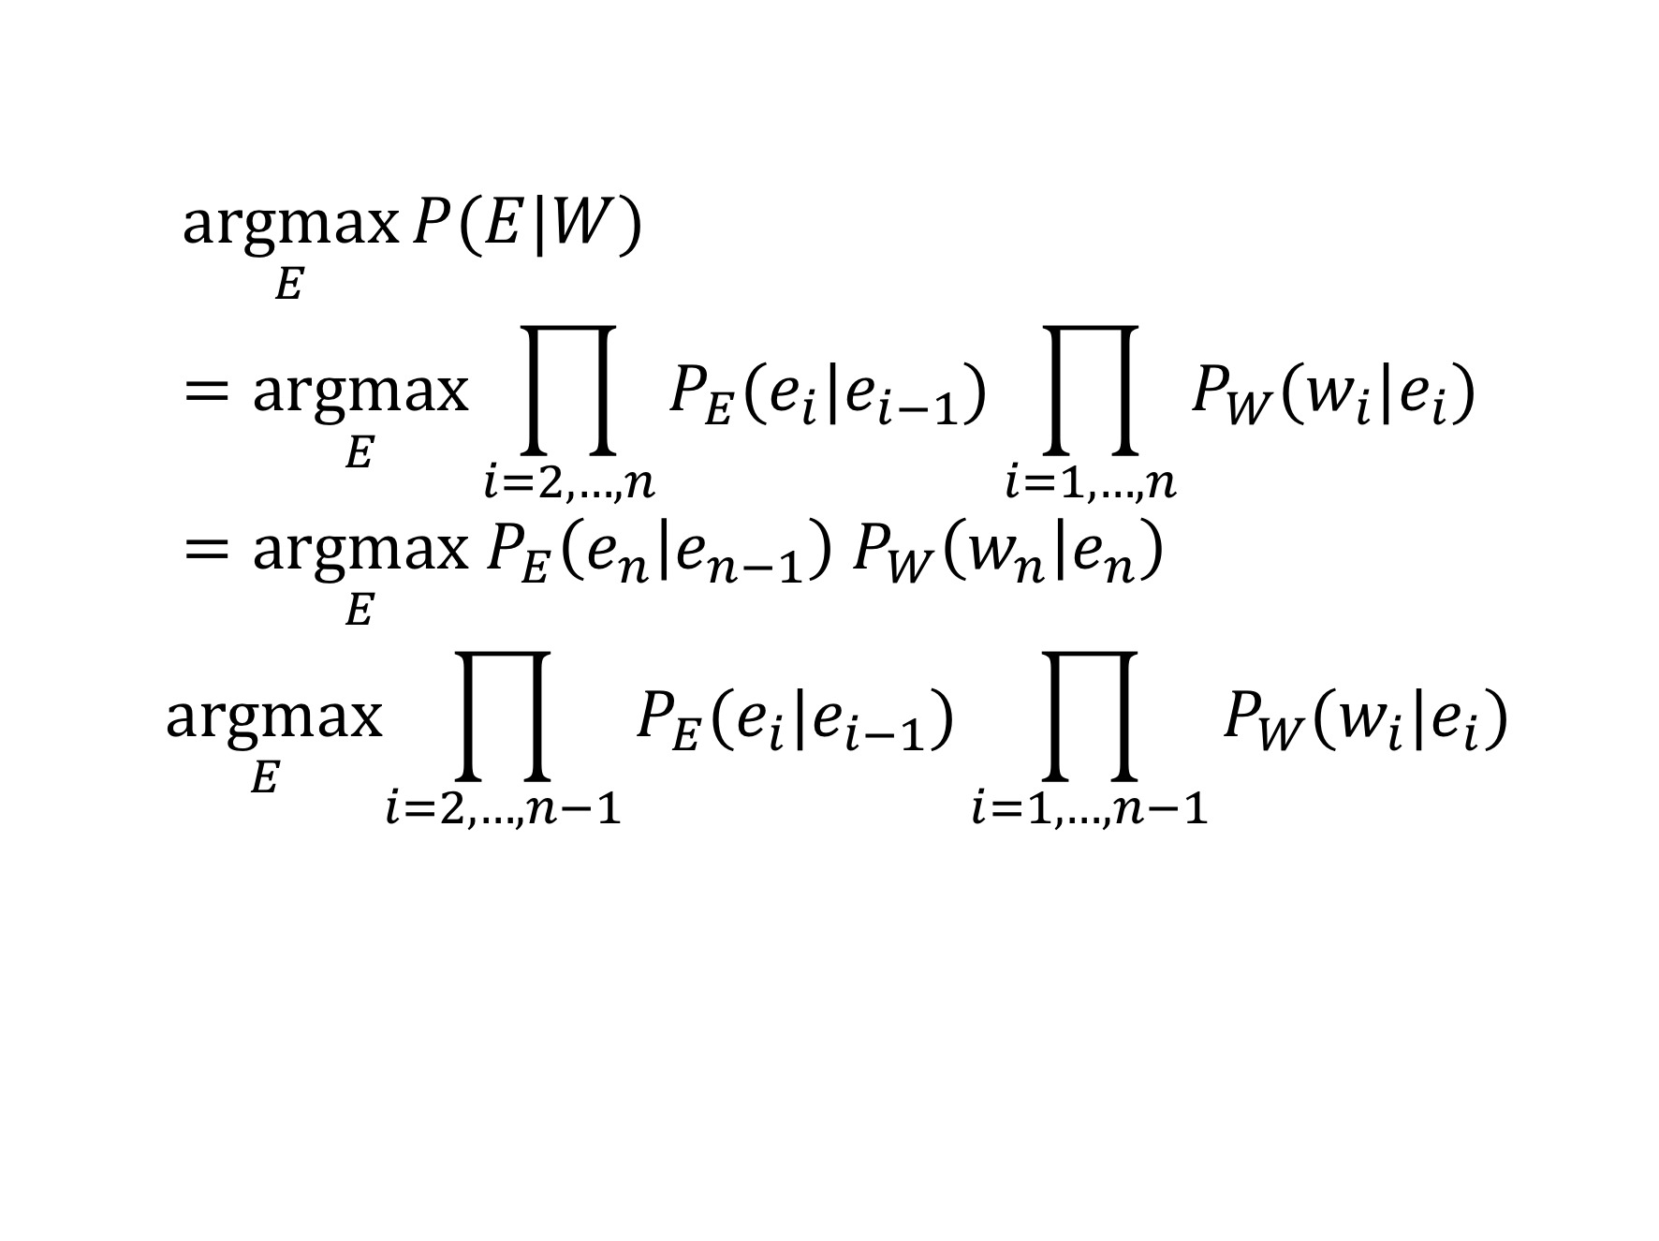

Observation
$$\underset{E}{argmax}{P(E|W)}=\underset{E}{argmax}\prod_{i=2,…,n}{P_{E}(e_{i}|e_{i−1})}\prod_{i=1,…,n}{P_{W}(w_{i}|e_{i})}=\underset{E}{argmax}{ P}_{E}\left(e_{n} | e_{n−1}\right) P_{W}\left(w_{n} | e_{n}\right)$$
$$\underset{E}{argmax}\prod_{i=2,…,n−1}{P_{E}(e_{i}|e_{i−1})}\prod_{i=1,…,n−1}{P_{W}(w_{i}|e_{i})}$$
Independent of the choice of $e_{n}$
Notes:
We made an independence assumption on the probabilities of the elements of a label sequence, where a label depends only on its predecessor in the sequence. We can exploit this independence assumption to simplify the computation of the sequence probability. The choice of the the last label in the sequence that maximizes the overall probability is independent of the choices of the other labels in the sequence maximizing the overall probability. Using this property simplifies the computation of the sequence probability significantly. Note tha

Slide 24
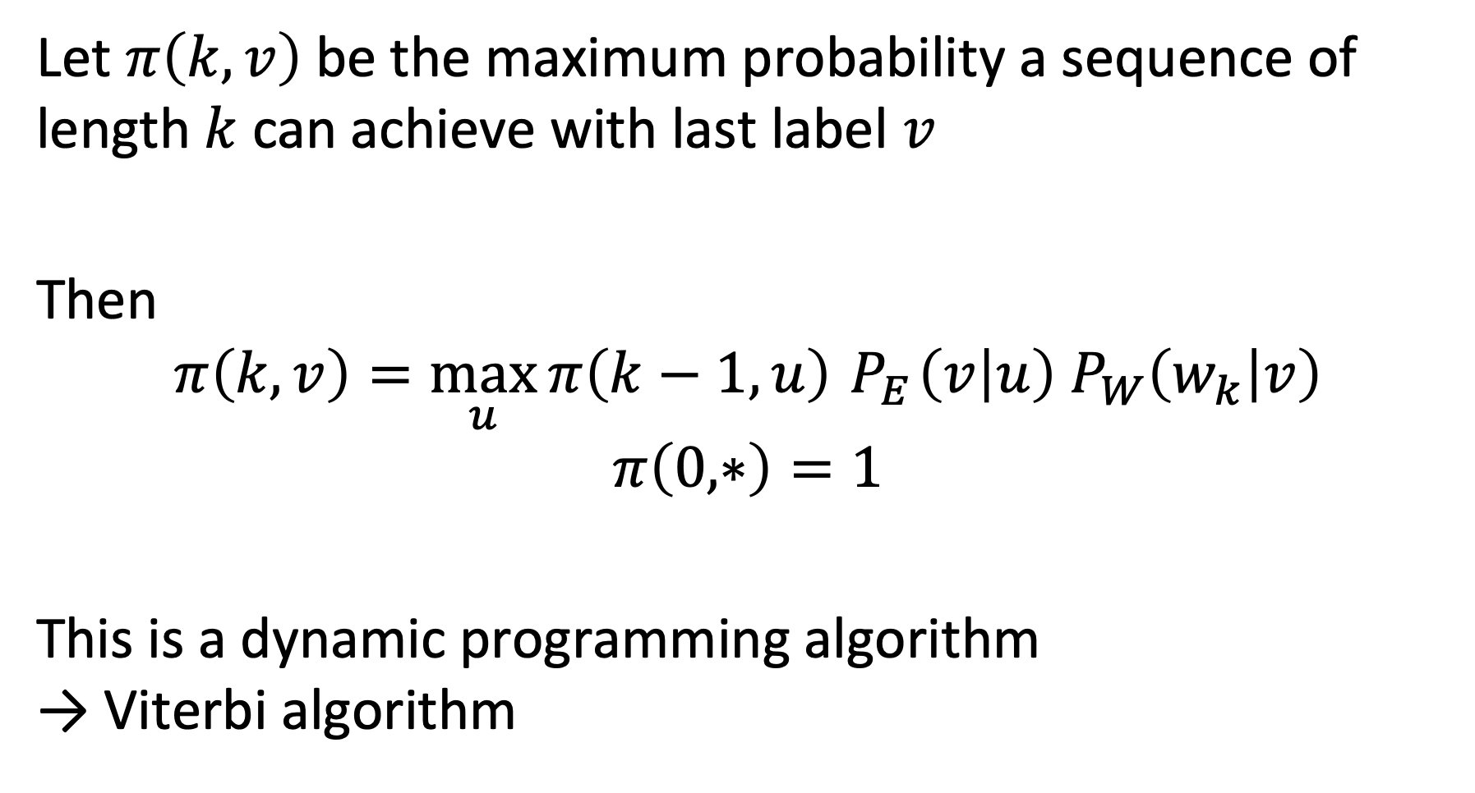
Viterbi Algorithm
Let $π\left(k,v\right)$ be the maximum probability a sequence of length $k$ can achieve with last label $v$
Then
$$π\left(k,v\right)=\max_{u}{π\left(k−1,u\right)}{ P}_{E}\left(v | u\right) P_{W}\left(w_{k} | v\right)$$
$$π\left(0,∗\right)=1$$
This is a dynamic programming algorithm → Viterbi algorithm
Notes:
Using the independence assumption described before, we can iteratively compute the sequence of labels that maximizes the probability, using in each step the label sequence found so far. The maximum probability $π\left(k,v\right)$ that a label sequence of length $k$ can achieve, if the last label is v can be computed from the maximum probabilities known for shorter sequences and the parameters of the probabilistic model.
This algorithm is a simple version of Viterbi’s algorithm. In its general form a random variable can depend on several earlier random variables in the earlier sequence, resulting in a dynamic programming algorithm.

Slide 25
An HMM model would not be an appropriate approach to identify
Named Entities
Part-of-Speech tags
Concepts
Word n-grams

Slide 26
Which statement is correct?
The Viterbi algorithm works because words are independent in a sentence
The Viterbi algorithm works because it is applied to an HMM model that makes an independence assumption on the word dependencies in sentences
The Viterbi algorithm works because it makes an independence assumption on the word dependencies in sentences
The Viterbi algorithm works because it is applied to an HMM model that captures independence of words in a sentence

Slide 27

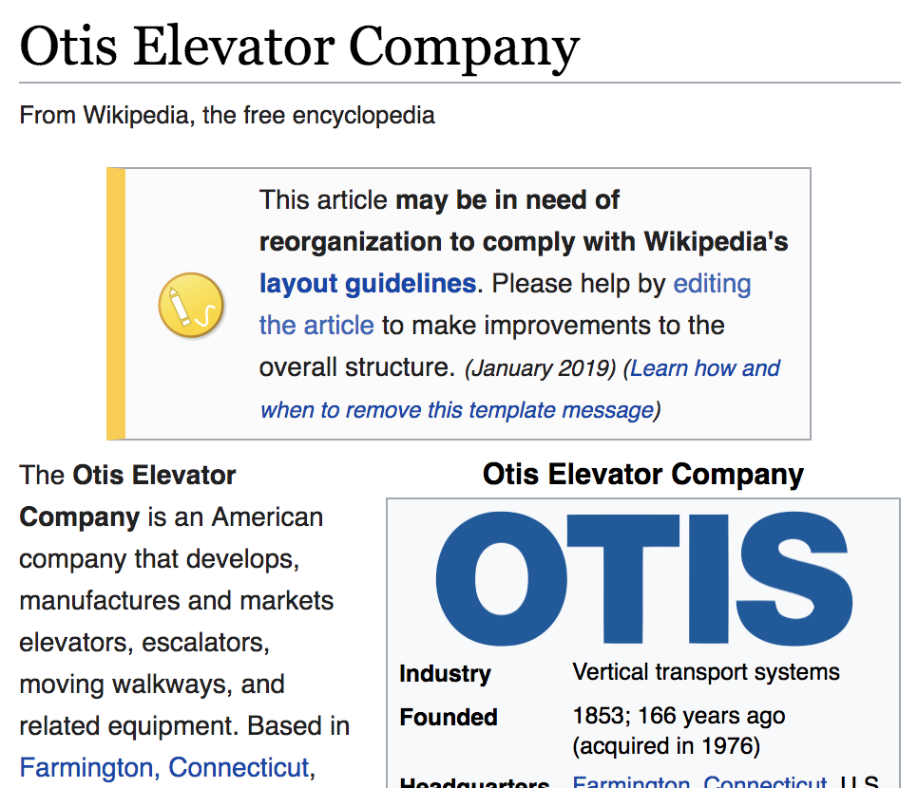
4.1.3 Entity Disambiguation
Task: Link a text mention in a document to an entry in a knowledge base (e.g., WikiPedia or WikiData)
Also called entity resolution and linking
Example: “Schindler is a Swiss industrial company. One of its main competitors is the American producer, Otis.”
Notes:
Once entities have been recognized in a text, one can link them to their corresponding counter-parts in a knowledge base. So-called entity disambiguation is a step that usually follows named entity recognition.

Slide 28
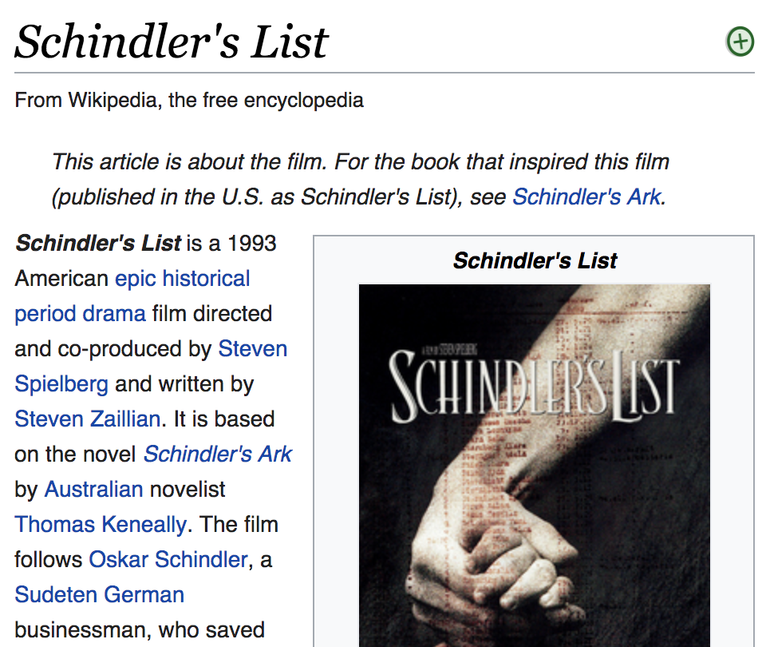
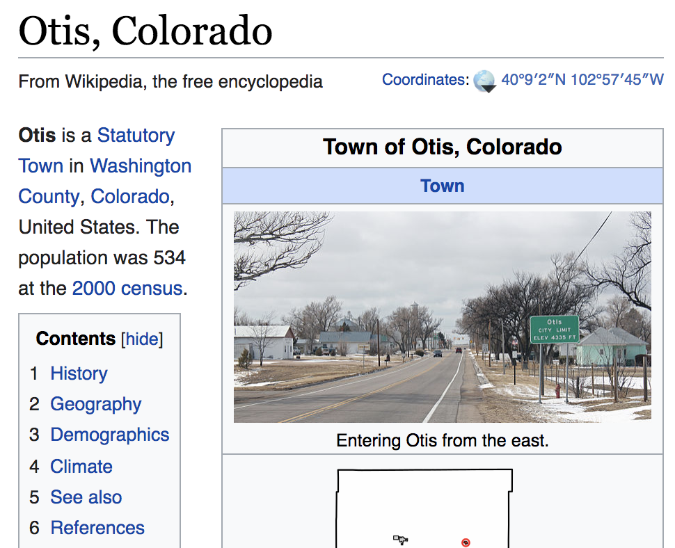
Challenge
Two problems
Homonyms: entities with the same name
Synonyms: different names for the same entity
Notes:
Entity disambiguation can however be quite challenging due to homonymy and synonymy. Handling these problems is essential for every text analytics tasks. Not being able to handle homonymy usually results in the introduction of noise into the results (poor precision), whereas not properly handling synonymy risks to miss relevant documents (poor recall).

Slide 29
Sources of Information
Local information: textual similarity of a mention of the entity and the entry in the knowledge base
Example: “Schindler” ≈ “Schindler’s list”
”Schindler” ≈ “Schindler Group”
Global information: coherence of different text mentions of potential entities within a document with respect to a knowledge base
→ entity graph
Notes:
For performing entity disambiguation one can exploit two different sources of information.
1. Local information extracted from the text mention, or its vicinity. This can be used to compare the text mention and its features with the text entry in the knowledge base, in order to obtain evidence which entities in the knowledge base are potential matches.
2. Coherence of different text mentions and knowledge base entries. When multiple entities are extracted from text, they will have relationships among each other. By analyzing whether the relationships among entries in the text and in the knowledge base are consistent with which each other one can disambiguate mentions of entities in the text.

Slide 30
Example Knowledge Graph
Schindler Holding
Schindler’s List
Switzerland
Relationships in the knowledge graph
American
Otis Elevator Company
Otis, Colorado
Notes:
We will give now an example to illustrate the process of entity disambiguation using a knowledge graph. Assume the knowledge base contains the subgraph shown in the figure, with entities that apparently are relevant to our text example.

Slide 31
Entity Graph
“Schindler is a Swiss industrial company. One of its main competitors is the American producer, Otis.”
m₁ = “Schindler”
e₁₁ = (c₁₁, m₁)
e₁₂ = (c₁₂, m₁)
Schindler Holding
Schindler’s List
“Swiss”
Switzerland
American
Otis Elevator Company
Otis, Colorado
s = (c₂, m₂)
“American”
Possible interpretations of mention m in the knowledge base by a concept c using local information
m₂ = “Otis”
Notes:
In a first step the textual mentions of the entities are linked to entries in the knowledge graph. After performing NER, this can be done using local information, textual similarity between the text mention and the name of the concept in the knowledge graph. By linking the text mentions we create entity matches of the form e = (c, m), where e is a node in the entity graph, c is the concept from the knowledge graph, and m is the textual mention of an entity in the text. The entity graph consists of all matched nodes in the knowledge graph, and the relationships among them. We may also associate a similarity measure to each node in the entity graph, capturing how well the text mention matches the concept in the knowledge graph.

Slide 32
Entity Graph
Entry e₁₁ has many more connections to the
other matched entries than entry e₁₂
m₁ = “Schindler”
e₁₁ = (c₁₁, m₁)
?
e₁₂ = (c₁₂, m₁)
Schindler Holding
Schindler’s List
“Swiss”
Switzerland
Links in the knowledge base
American
Otis Elevator Company
Otis, Colorado
s = (c₂, m₂)
?
“American”
m₂ = “Otis”
Notes:
The example shows that different interpretations are possible for both the mention “Schindler” and “Otis”. Therefore, the problem is to decide which if each these two alternative matches is the better one. A possibility indication for the quality of a match is the connectivity of the nodes with the other nodes in the entity graph.

Slide 33
Coherence
How well does the node s
support the choice of node e?
Other formulation: How relevant is node e for node s?
(as compared to e’, an alternative node)
e
e’
s
Notes:
Abstracting from the details of the example before, we can highlight the problem we need to solve. Given two alternative interpretations of a text mention, e and e’, and another node s in the entity graph, how well does the node s support the two alternatives. In the example graph we see that intuitively node s is much better connected with node e which indicates that e might indeed be the better choice.
The problem described bears similarity with another problem that has been addressed in the context of personalized Web search. Imagine the nodes are Web pages, s is a page that has been bookmarked by a user, and the question is which other pages, like e and e’, are also of interest to the user. From the example, it appears evident that it is page e. For making this intuition on connectedness operational, a variant of the PageRank algorithm has been proposed, called Personalized PageRank. The same algorithm has also been used to solve entity disambiguation.

Slide 34
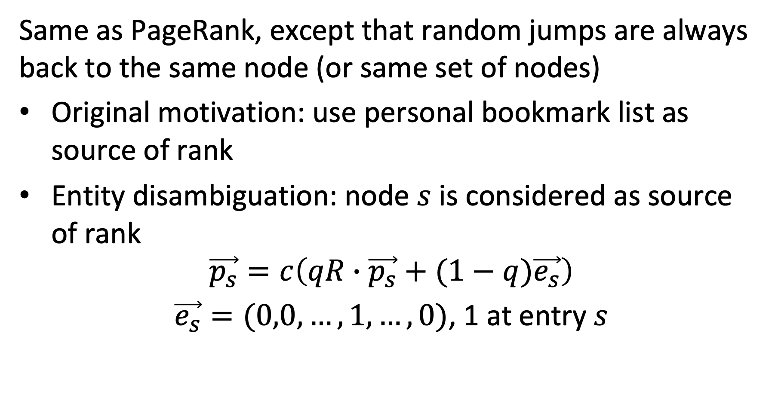
Personalized PageRank
Same as PageRank, except that random jumps are always back to the same node (or same set of nodes)
Original motivation: use personal bookmark list as source of rank
Entity disambiguation: node $s$ is considered as source of rank
$$\vec{p_{s}}=c\left(qR∙\vec{p_{s}}+(1−q)\vec{e_{s}}\right)$$ $\vec{e_{s}}=(0,0,…,1,…,0)$, 1 at entry $s$
Notes:
Personalized PageRank works almost the same as the original PageRank algorithm. The difference is that random jumps are not performed uniformly at random to nodes, but to a selected subset of nodes. In the context of personalized Web search this subset would be the personal bookmark list. By jumping back to the nodes from that list, it will have a large influence on the ranking of a page, such that nodes that are well connected to the bookmarks will receive a larger ranking value. In the context of entity disambiguation, the source is a selected node in the entity graph, and personalized page rank is used to compute how well other nodes in the entity graph are supported by that node.

Slide 35
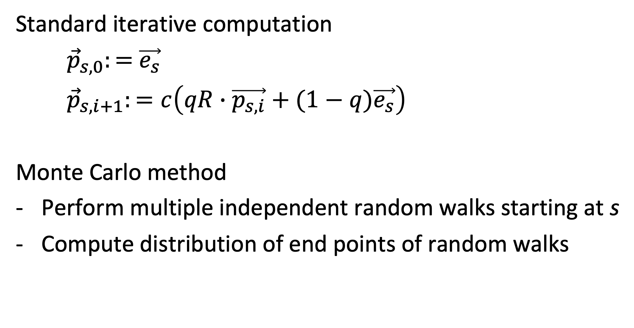
Computing PPR
Standard iterative computation
${\vec{p}}_{s,0}:=$ $\vec{e_{s}}$
${\vec{p}}_{s,i+1}:=c\left(qR∙\vec{p_{s,i}}+(1−q)\vec{e_{s}}\right)$
Monte Carlo method
Perform multiple independent random walks starting at s
Compute distribution of end points of random walks
Notes:
PPR can be computed either iteratively, like standard PageRank, or using a Monte Carlo method, by starting random walks independently at s and aggregating the distribution of the end points of those walks.
The Monte Carlo method is more appropriate for computing Personalized PageRank compared to general PageRank due to several key reasons:
1. **Personalization and Specificity**: Personalized PageRank computes the PageRank from the perspective of individual nodes, tailoring the importance of pages based on a specific user or set of starting nodes. The Monte Carlo method, which involves random sampling, is particularly well-suited for this task because it can efficiently handle the stochastic nature of personalized browsing. It can simulate random walks from specific starting nodes, effectively capturing the personalized view of the web graph.
2. **Scalability and Efficiency**: General PageRank involves computing the importance scores for all nodes in the web graph, which can be computationally intensive for large graphs. In contrast, Personalized PageRank focuses on a subset of nodes relevant to the specific user or context. The Monte Carlo method allows for efficient computation in such cases, as it does not require processing the entire graph. It can provide good approximations with a relatively small number of random walks, making it scalable for large graphs when personalization is needed.
3. **Dynamic and Adaptive**: Personalized PageRank may need to be recalculated frequently, especially in dynamic networks where user preferences or the graph itself can change rapidly. The Monte Carlo method allows for more flexible and quicker updates compared to the traditional iterative methods used for general PageRank. It can easily adapt to changes in the graph or the starting nodes without needing a full recomputation.
4. **Reduced Computational Overhead**: In general PageRank, the goal is to find a stationary distribution of the entire graph, which often requires numerous iterations over the entire graph to converge. The Monte Carlo method, when used for Personalized PageRank, significantly reduces this computational overhead since it focuses on specific parts of the graph related to the personalized context.
In summary, the Monte Carlo method's strengths in handling stochastic processes, scalability, adaptability to dynamic environments, and reduced computational requirements for targeted computations make it particularly well-suited for Personalized PageRank compared to the more globally-oriented general PageRank.

Slide 36
PPR on Entity Graph
?
Source node s supports concept c₁₁
e₁₁ = (c₁₁, m₁)
e₁₂ = (c₁₂, m₁)
PPR_{s}(e₁₁) = high
PPR_{s}(.) = 0
e
PPR_{s}(.) = medium
s
PPR_{s}(.) = medium
PPR_{s}(s) = high
PPR_{s}(.) = 0
Notes:
Applying PPR to the entity group, by considering a source node s as the source of rank, will generate a distribution of ranking values for all other nodes. Nodes that are well connected to s will receive higher ranking values. Intuitively it is clear, that in our example node e will be receive higher ranking when starting from s, and thus is the preferred interpretation for the entity matching mention m₁.

Slide 37
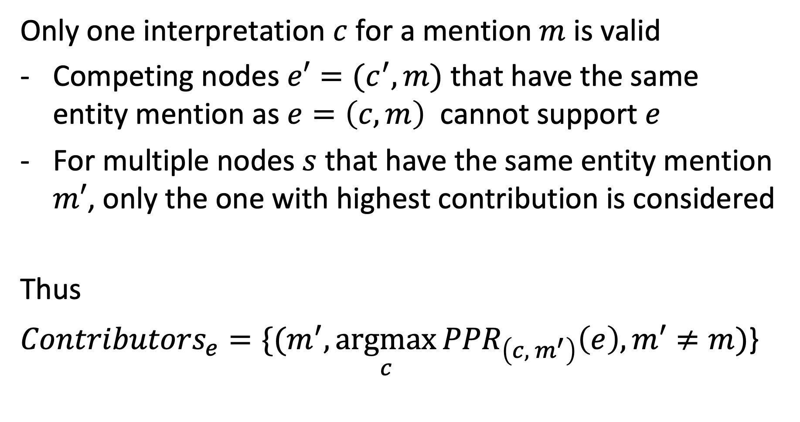
Contributing Source Nodes
Only one interpretation $c$ for a mention $m$ is valid
Competing nodes $e′=(c^{′},m)$ that have the same entity mention as $e=\left(c,m\right)$ cannot support $e$
For multiple nodes $s$ that have the same entity mention $m′$, only the one with highest contribution is considered
Thus
${Contributors}_{e}={\{(m}^{′},\underset{c}{argmax}{{PPR}_{\left(c, { m}^{′}\right)}\left(e\right),m′≠m)}$}
Notes:
The question is which nodes s should contribute to the disambiguation of a mention m. The considerations for choosing those nodes take into account the following two issues:
When we are computing the support for an interpretation $e=\left(c,m\right)$ of text mention m, with competing interpretations $e′=(c^{′},m)$ , the competing node should not be used to produce support for e. So, these nodes are excluded.
When there exist multiple nodes for a text mention m’ , only the one that is producing the largest contribution to the interpretation $e=\left(c,m\right)$ of text mention m is considered. This makes sense, since the other nodes related to m’ might favor an alternative interpretation for m, and therefore should not be considered.
This results in a set of contributing nodes ${Contributors}_{e}$ for each node $e=\left(c,m\right)$ in the entity graph.

Slide 38
Example: Contributors_{e}
PPR_{s}(e) = high
PPR_{s}(.) = 0
Competing node
e
PPR_{s}(.) = medium
s
PPR_{s}(.) = medium
Lower contribution
PPR_{s}(s) = high
PPR_{s}(.) = 0
Notes:
This figure shows that for the computation of the score of node e using node s as source, two nodes from the entity graph will be excluded. First, the node that is linked to the same text mention as e and is a competing node, and second the node that is linked to the same text mention and s and is producing a lower score.

Slide 39
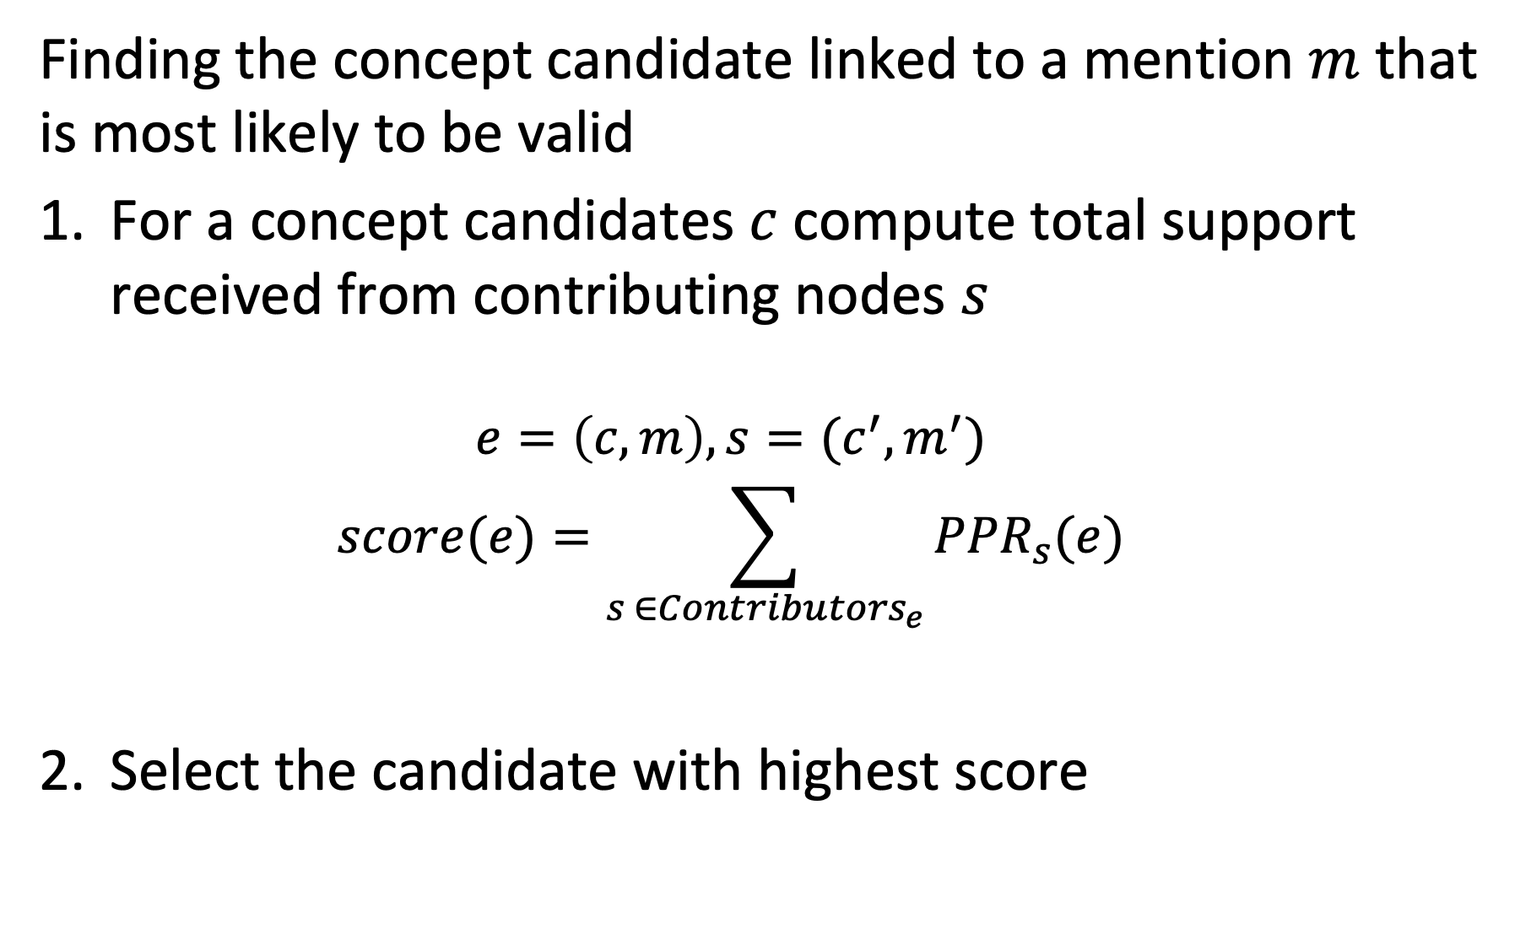
Scoring
Finding the concept candidate linked to a mention $m$ that is most likely to be valid
For a concept candidates $c$compute total support received from contributing nodes $s$
$$e=\left(c,m\right), s=(c^{′},m^{′})$$
$$score(e)=\sum_{s ∈{Contributors}_{e}}{{PPR}_{s}(e)}$$
Select the candidate with highest score
Notes:
Using the contributing nodes, the personalized PageRank scores that they contribute are added and the candidate with the best score is selected.

Slide 40
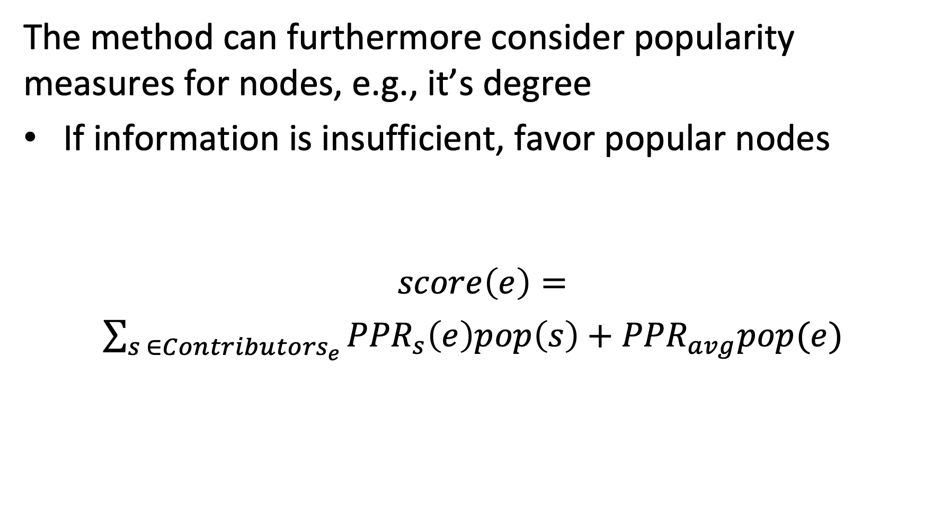
Considering Popularity
The method can furthermore consider popularity measures for nodes, e.g., it’s degree
If information is insufficient, favor popular nodes
$$score\left(e\right)=$$ $\sum_{s ∈{Contributors}_{e}}{{PPR}_{s}\left(e\right)pop\left(s\right)}+{PPR}_{avg}pop(e)$
Promotes contributions from popular nodes
Promotes popular nodes
Notes:
To further improve the method, it is possible to add a general popularity measure as a weight the contributions of source nodes. This will favor the contribution of popular nodes, which is beneficial if little information is available for disambiguation. In such a case, it is better to choose a popular candidate since chances that an interpretation supported by a popular node are higher. One of possible choice of a popularity score could be the number of links a node has in the knowledge base. Similarly, also the popularity of the candidates e can be used as a contribution to the score.

Slide 41
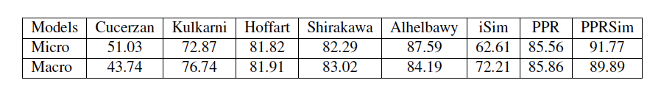
Some Results
Without popularity
Other methods
Uses pageRank
With popularity
Notes:
Experimental results show that the method works relatively well, with around 90% of entities that are correctly disambiguated. One can observe that the use of popularity helps to slightly improve the results.

Slide 42
Which is false?
Entity disambiguation addresses the problem of synonyms
Named entity recognition addresses the problem of synonyms
Entity disambiguation addresses the problem of entity classification
Named entity recognition addresses the problem of entity classification

Slide 43
Which nodes cannot contribute to the score of a mention linked to a concept?
Other concepts linked to the same mention
Concepts that have in the knowledge graph no outgoing links
Concepts that have in the knowledge graph no incoming links
Concepts with low popularity

Slide 44
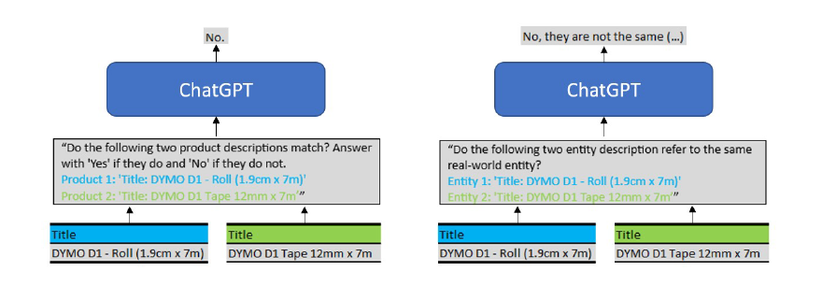
4.1.4 Entity Matching with GPT
GPT can be prompted to directly decide whether to entities are the same
- the challenge is to design good prompts

Slide 45
Considerations in Prompt Design
General vs. domain-specific
“are these entities the same?” vs. “are these products the same”
Simple vs. complex
”match” vs. “refer to the same real-world entity”
Free vs. forced answer
“answers with ‘yes’ or ‘no” vs. no instruction
Adding entity attributes
Adding price information or not

Slide 46
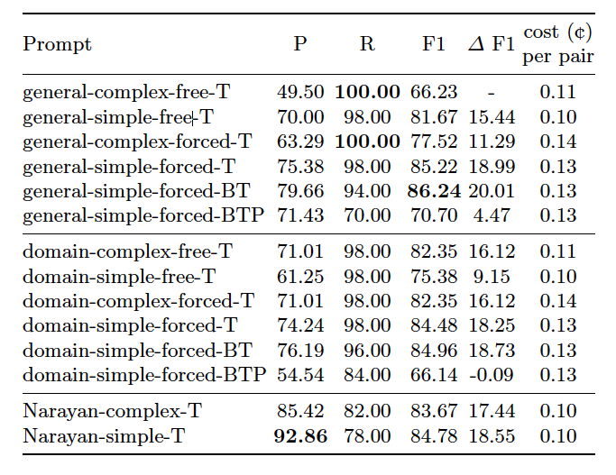
Sample evaluation results
Findings on what helps
- domain-specific wording
- simpler wording
- forcing an answer
Findings on what hurts
- price information or products (lack of normalization)

Slide 47
In-context Learning
Providing sample training data
Matches:
Product 1: 'Title: SANDISK EXTREME PRO SDHC 32GB 300MB/S UHS-II U3' Product 2: 'Title: Sandisk SDXC card Extreme Pro UHS-II, 32gb, 300mbps'
Product 1: 'Title: Dymo 53718 Black On Yellow - 24mm' Product 2: 'Title: Dymo 24mm Black On Yellow D1 Tape (53718)'
Product 1: 'Title: DS-7216HQHI-K1 Hikvision 16 cs. TurboHD DVR' Product 2: 'Title: Hikvision DS-7216HQHI-K1 Turbo HD DVR'
Product 1: 'Title: APCRBC133APC Replacement Battery Cartridge #133' Product 2: 'Title: APC RBC133 Replacement Battery Cartridge'
Product 1: 'Title: Gigabyte NVIDIA GeForce GTX 1650 4GB D6 OC Turing Graphics Card' Product 2: 'Title: GigaByte GeForce GTX 1650 D6 Windforce OC 4G'
Non-matches:
Product 1: 'Title: RAM Corsair ValueSelect DDR4 2133MHz 1x8Go' Product 2: 'Title: CORSAIR New 8gb (1x8gb) Ddr4 2666mhz Vengeance CMK8GX4M1A2666C16'
Product 1: 'Title: Evolis Zenius/Primacy Black Monochrome Ribbon 2000 image RCT023NAA' Product 2: 'Title: Zebra 800015-101 Black Monochrome Ribbon - 1000 Prints'
Product 1: 'Title: 128GB Pendrive SanDisk Extreme PRO SSD USB 3.1 420MB/s' Product 2: 'Title: SanDisk 128GB Extreme Pro SDXC 150MB/s V-30 UHS-1 U3 Memory Card'
Product 1: 'Title: Samsung SSD 970 EVO Plus 250GB' Product 2: 'Title: Samsung 970 EVO SSD M.2 2280 - 500GB'
Product 1: 'Title: Akumulator APC Replacement Battery Cartridge #110' Product 2: 'Title: APC - Replacement Battery Cartridge #117'
Do the following two product descriptions refer to the same real-world product? Answer with 'Yes' if they do and 'No' if they do not.
Product 1: 'Title: MEMORIA SD SANDISK ULTRA SDHC SDXC UHS I CARD 100 MBS SDSDUNR 256G GN6IN'
Product 2: 'Title: SanDisk Extreme Pro (256GB) SDXC Memory Card'

Slide 48
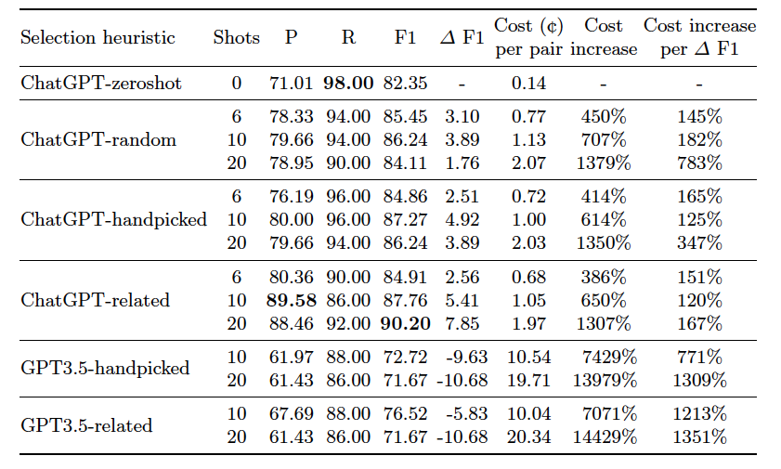
Evaluation Results
Findings
- in-context learning helps
- (lexcially) related terms work better than human selected
- cost increases significantly
Notes:
Lexically related = high Jaccard similarity

Slide 49
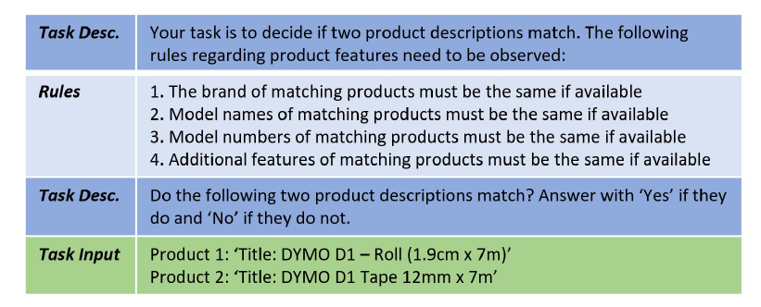
Providing Matching Rules

Slide 50
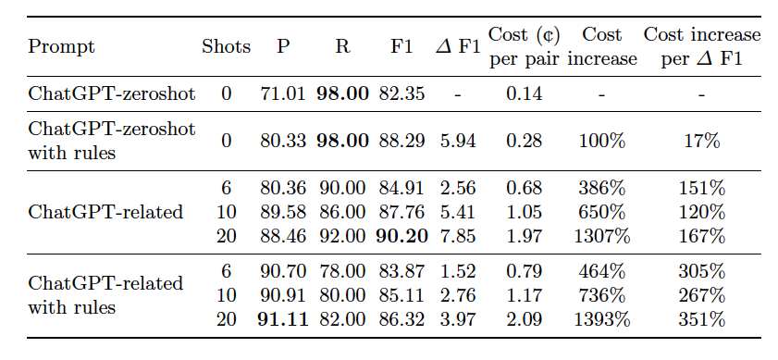
Evaluation Results
Findings
- rules with in-context learning increases precision at cost of recall
Note that rules do not require training data

Slide 51
References
Lecture partially based on
Dan Jurafsky and James H. Martin, Speech and Language Processing (3rd ed. Draft), Chapter 21 https://web.stanford.edu/~jurafsky/slp3/
Jay Pujara and Sameer Singh, Mining Knowledge Graphs from Text, Tutorial, https://kgtutorial.github.io
References
Mintz, Mike, et al. "Distant supervision for relation extraction without labeled data." ACL 2009.
Riedel, S., Yao, L., McCallum, A., & Marlin, B. M. Relation extraction with matrix factorization and universal schemas. ACL 2013.
Ralph Peeters and Christian Bizer, “Using ChatGPT for Entity Matching”, ADBIS 2023

